Slide 1
Stack

Slide 2
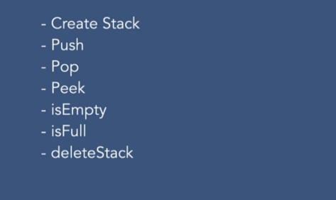
Operations
Create stack
Push: Insert an element
Pop: remove an element. Returns popped element
Peek: get the first element / last inserted.
isEmpty: check if stack is empty if implemented with arrays.
isFull: Check if it is full
deleteStack: delete stack

Slide 3
Implementation
Array
Linked List
Easy to implement
Fixed Size
Variable size
Not easy to implement

Slide 4
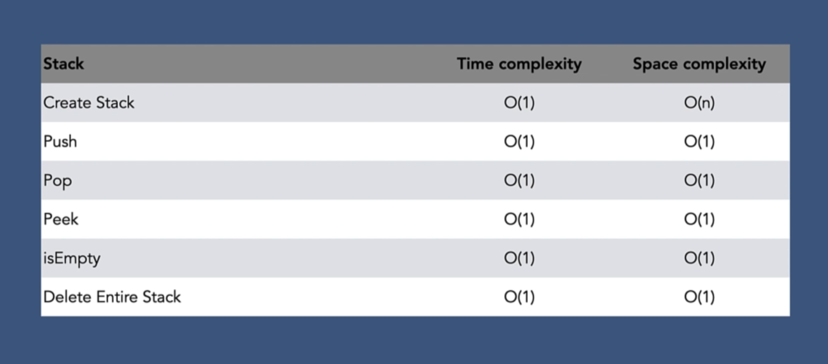
Complexity of Stack Array

Slide 5
Stack
Linked List

Slide 6
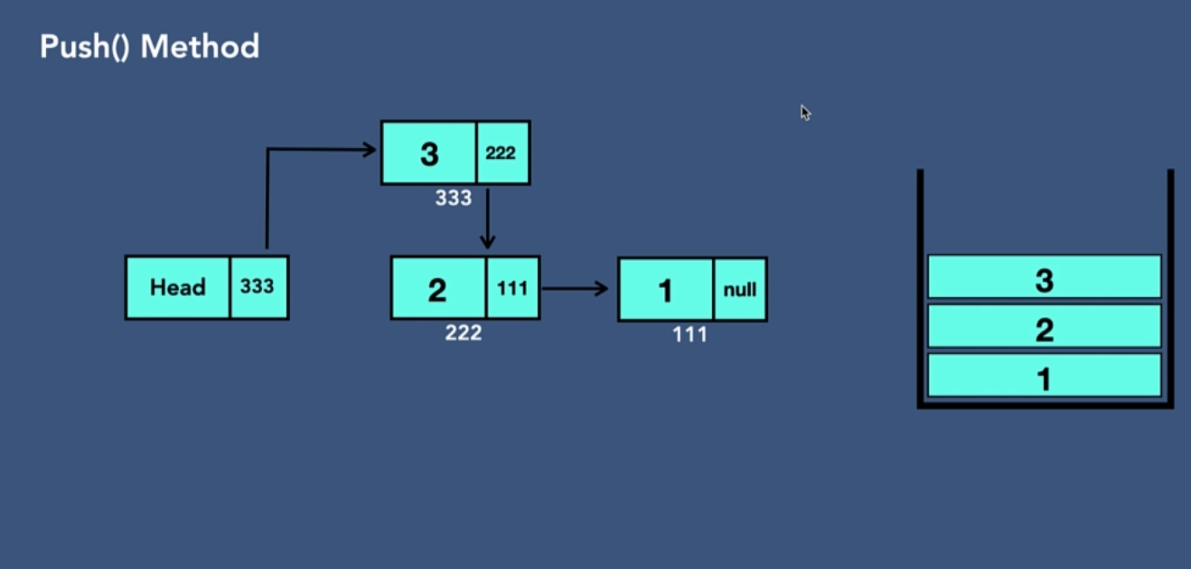
Pushing to the stack It is insert at the beginning

Slide 7
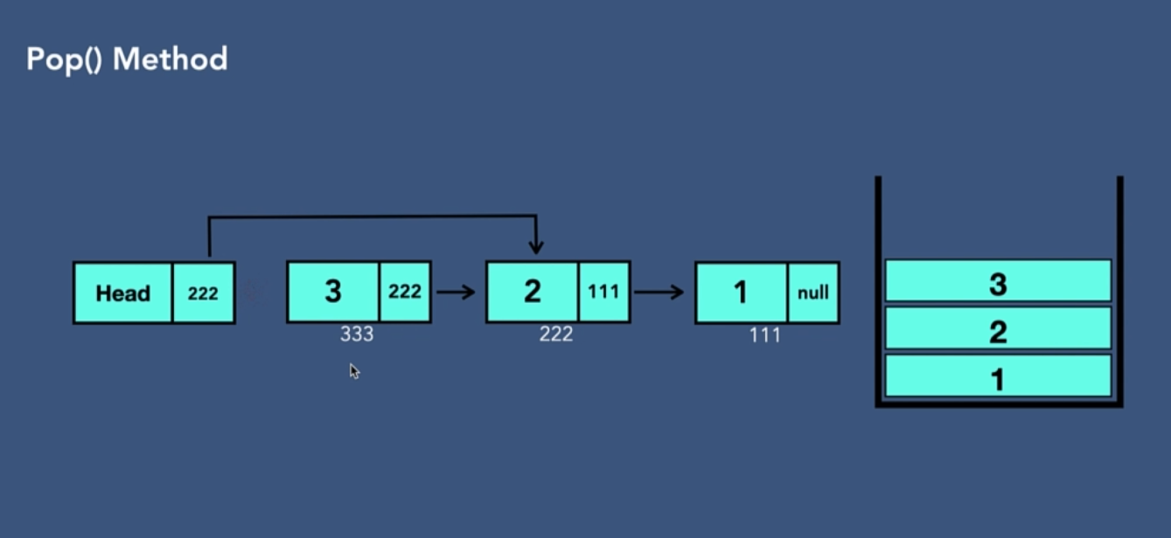
Pop Remove at the beginning

Slide 8
Peek Returns head value / top element

Slide 9

Delete Set head to null

Slide 10
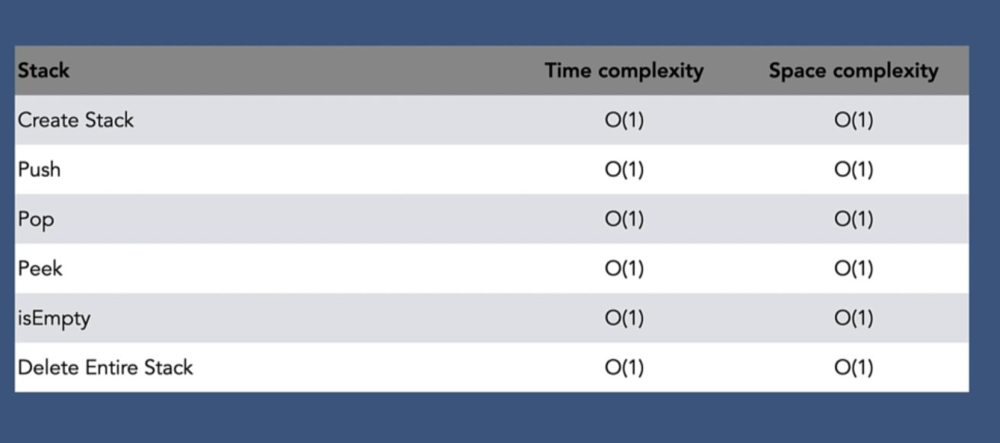
Complexities

Slide 11
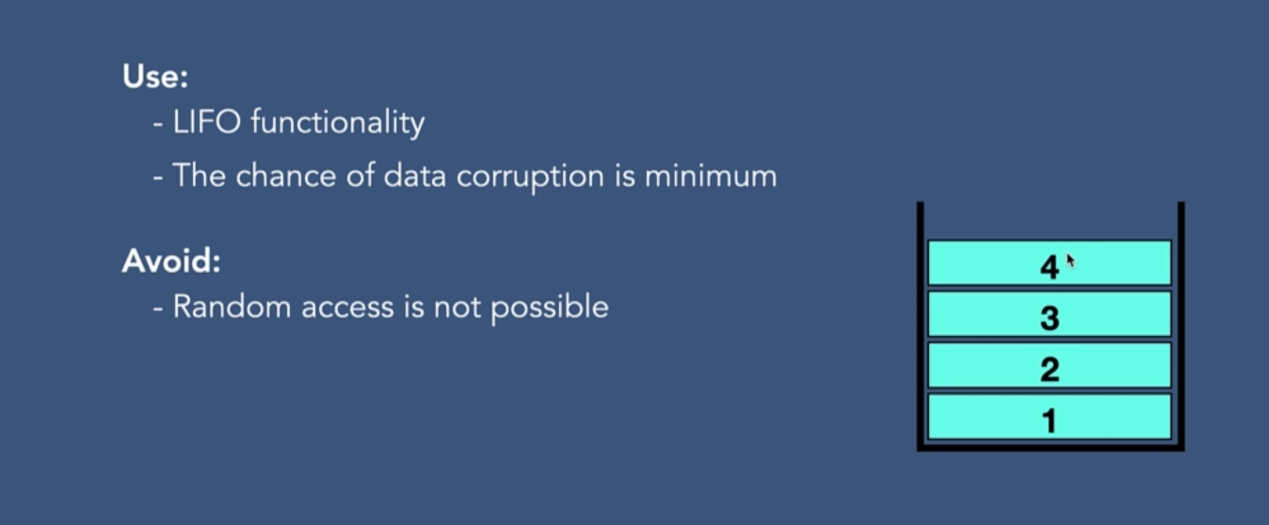
Why and why not Stack

